Slide 1

Soccer Network Analytics
Katie , Aman, Philip, Alex Su

Slide 2
Story Behind :
Aman is a newbie in professional soccer. He is full of dreams and hopes to become top player just like Messi. In order to make his dream come true, he has done some research and asked a bunch of experts about how to gain his value and reputation. He found out through getting into best club and making good connections with top players are the two best ways to achieve his goal of becoming the best player in the world.
His story begins…

Slide 3
Background Overview
Leagues are composed of many clubs which are composed of many players
  Some leagues are better than others
  Clubs play other clubs in their league
  Players are traded across clubs regardless of league
Players typically change clubs frequently
  Each time they switch club they build relationships with players on their new club
  Relationships with other high value players are tend to be high value as well
  Lower value, less experienced players tend to change clubs more often

Slide 4
Target Problem
Problem 1: Identify springboard clubs *
Problem 2: Finding the most prospective player to connect.
*Springboard Clubs: Clubs which a newbie enters, gains experience, and is sold to best clubs in the world

Slide 5
What questions do we want to explore?
What is the top player for each age?
Which club is the best “spring board”?
Which clubs have players that end up at the top clubs?
  Which clubs are the top clubs?
    By value? By Ranking?
    Is there a correlation between ranking and the value of a club?
  Which clubs have the best relationships?
    Which centrality measure is the best?
  What’s a player’s value based on market value, network ties & experience?
  Who are the top players at a certain age group?
  Who are the best players at a given position?
  How are players improving over time?
  Which players have the best connections?
  Which measure is most important for players?

Slide 6
Let’s explore the data
The dataset gives information on football players, clubs and leagues across the world.
Player Data
Club Data
League Data
Ties between players based on who has been on the same club
Market Value of player
Time
Player position
club & League
Ties exist between clubs when they trade with each other
Market Value of club
Time
League of the club
Players on the club
club rank within their league
Shows clubs in each league and the country
Shows subjective ranking of leagues
  Not all leagues are created equal
Time

Slide 7
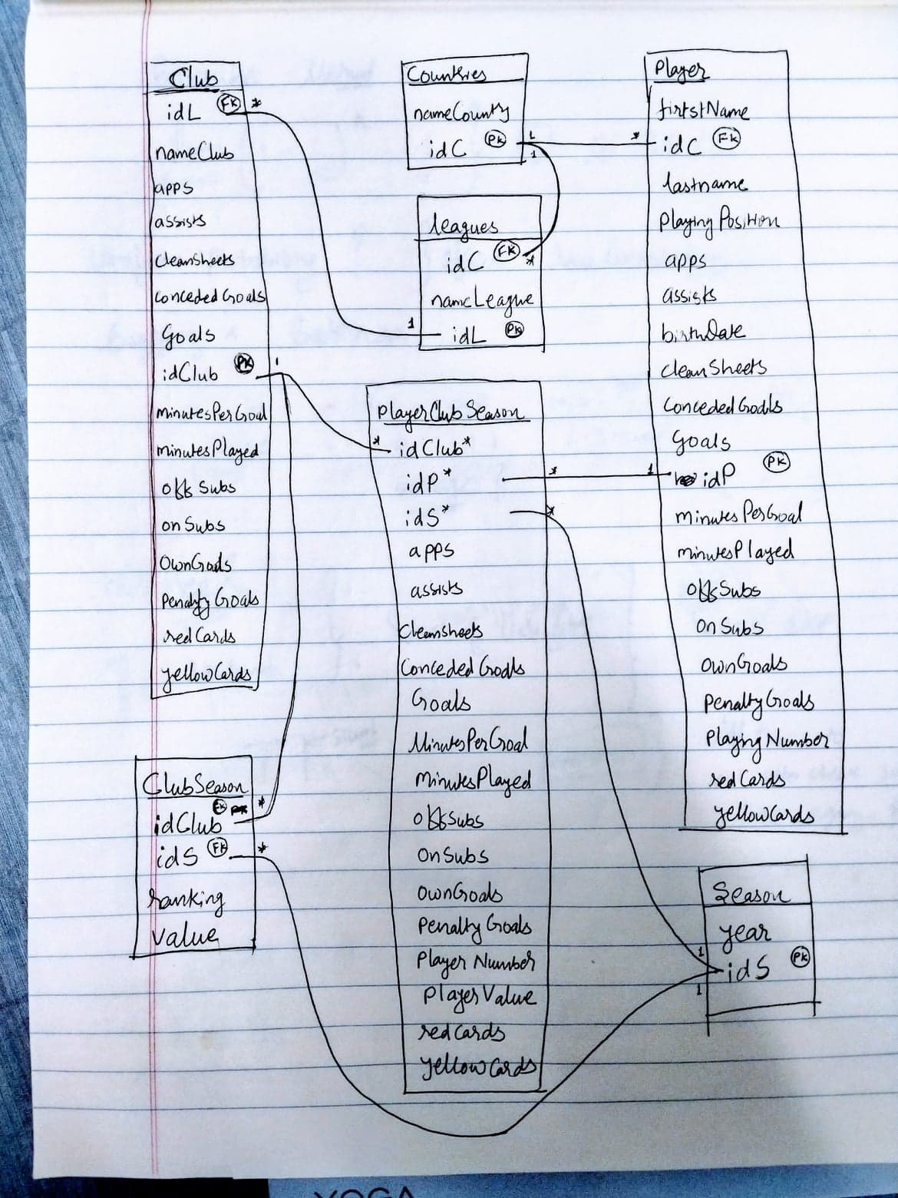
Let’s explore the data
The dataset gives information on football players, clubs and leagues across the world.
Player Data
Club Data
League Data

Slide 8
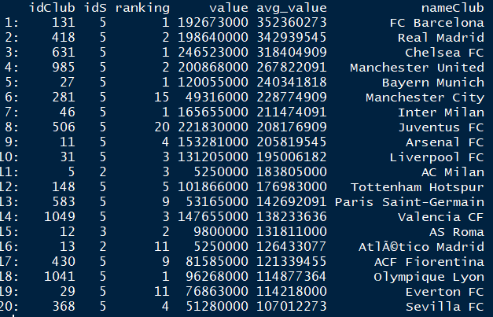
Top Clubs
club ranks are figured out based on the average value over all seasons.

Slide 9
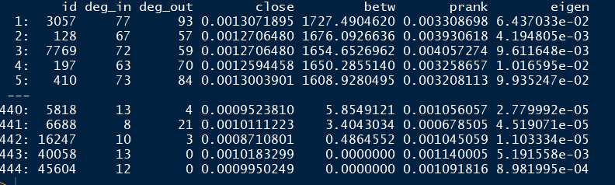
Best Spring Board club
The best spring board club is compared by different centrality method
A club is considered a springboard if it is involved in a lot of transfers to the most valuable clubs. So, the betweenness centrality is the most suitable measure

Slide 10
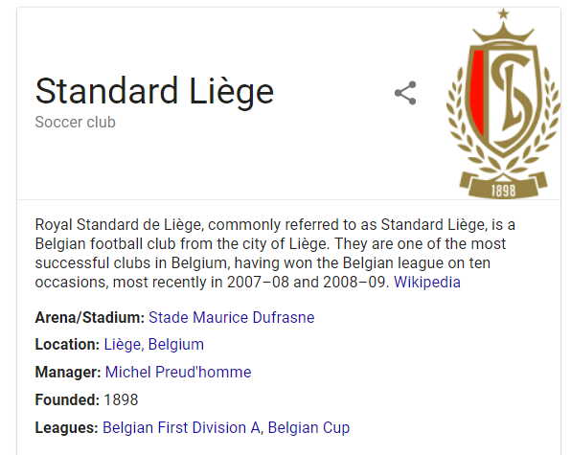
Best Spring Board club - Standard Liege

Slide 11
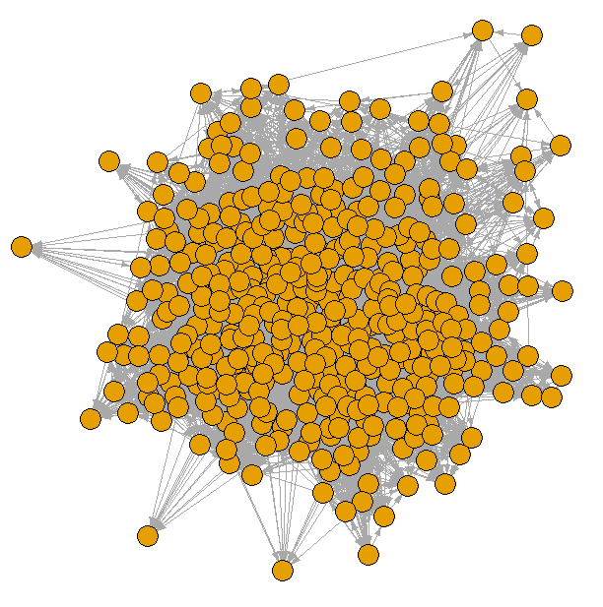
Club Nekwork
club connection based on transactions they’ve done

Slide 12
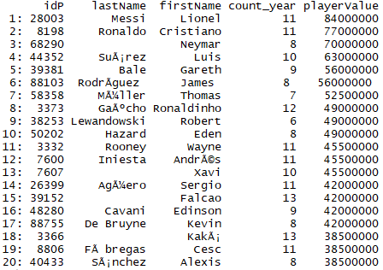
Top Players
Player ranks are figured out based on market value

Slide 13
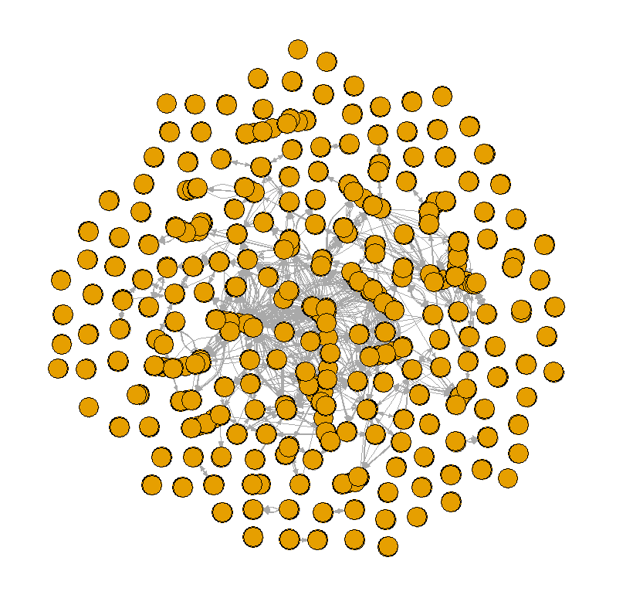
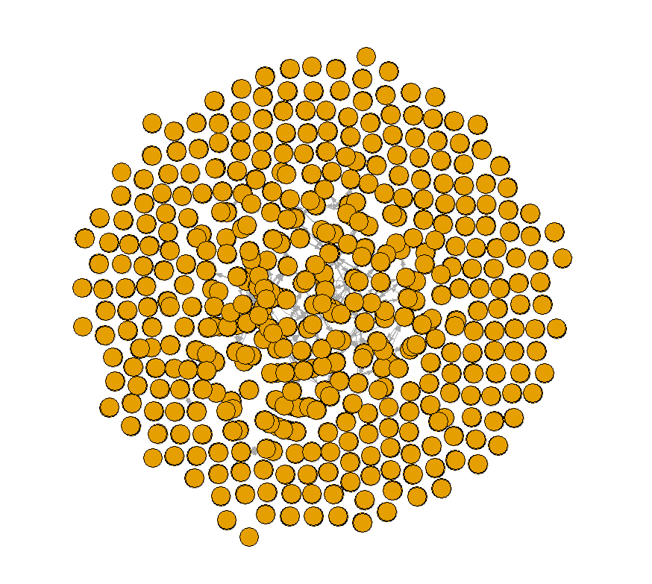
Player Network
Player connection based on whether players are in the same club
Season 2
Season 8

Slide 14
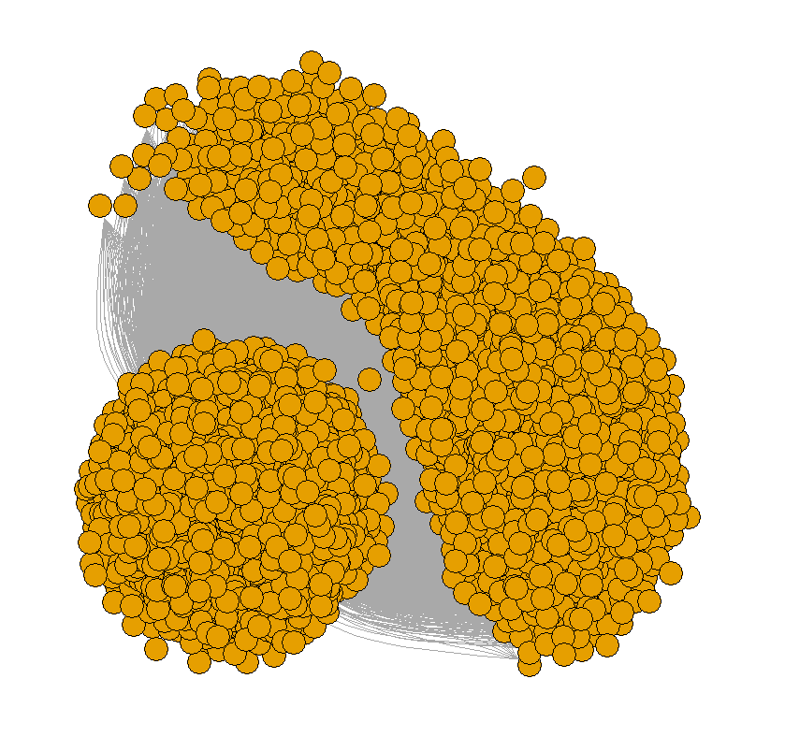
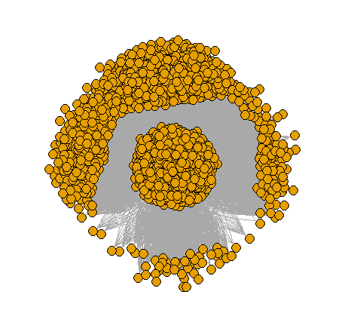
Player Network
Player connection with weight = (player value x + player value y) /100000
Season 2
Season 8

Slide 15
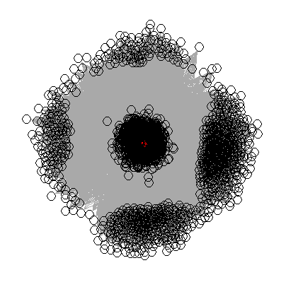
Lionel Messi – Season 8

Slide 16
Expectations & Future Analysis
The algorithm can be modified to use rank by giving weighted levels for each league, with the help of domain experts.
We can incorporate variables such as club managers and how club policies change over time for more accurate results.
The data about the skill level can be utilized to predict the position of a player in the whole network after a particular time.

Slide 17
Thank you!

